Slide 1



The Vital Importance of the Rio Conventions

Slide 2


Addressing Global Challenges
Biodiversity Loss
The Rio Convention on Biological Diversity tackles the critical issue of declining plant and animal species worldwide.
Climate Change
The UN Framework Convention on Climate Change aims to stabilize greenhouse gas concentrations and mitigate global warming.
Desertification
The Convention to Combat Desertification works to reverse land degradation and protect vulnerable ecosystems.

Slide 3
Guiding Principles of the Rio Conventions
Sustainable Development
Shared Responsibility
Precautionary Approach
All countries must cooperate to address these borderless challenges through collective action.
Taking preventative measures even without full scientific certainty to avoid irreversible harm.
Balancing environmental protection with economic progress and social wellbeing for present and future generations.

Slide 4

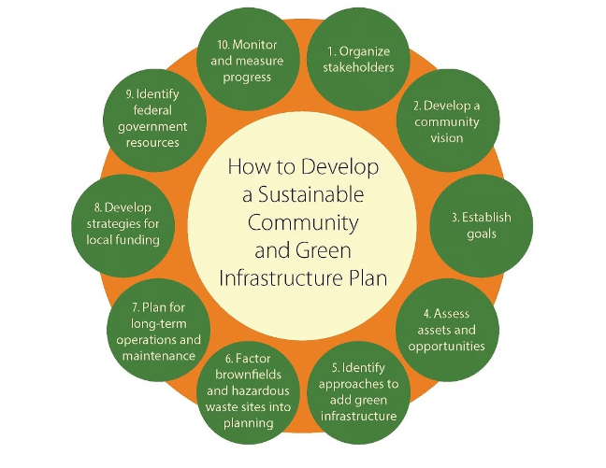
Achievements of the Rio Conventions
1
Raised Awareness
Heightened global consciousness about critical environmental issues.
2
Strengthened Cooperation
Facilitated international collaboration and knowledge-sharing.
3
Catalyzed Action
Spurred governments, businesses, and citizens to adopt sustainable practices.

Slide 5




The Path Ahead
Set Ambitious Goals
Establish bold, science-based targets to drive transformative progress.
Mobilize Resources
Secure adequate financing and technology transfer to support developing nations.
Foster Accountability
Implement robust monitoring and compliance mechanisms for tangible results.

Slide 6





Empowering Local Communities
Indigenous Knowledge
Recognize and utilize traditional environmental stewardship practices.
Gender Equity
Ensure women's meaningful participation and leadership in decision-making.
Youth Engagement
Empower the next generation as agents of change and innovation.

Slide 7
Synergies Across Conventions
Interlinkages
Integrated Approach
Cross-cutting Themes
The Rio Conventions' goals are interdependent and mutually reinforcing.
Coordinated implementation can maximize co-benefits and minimize trade-offs.
Issues like climate, land, and biodiversity require a holistic, systems-based response.

Slide 8


Harnessing Innovation
1
Digital Technologies
Leverage data, AI, and remote sensing to enhance monitoring and decision-making.
2
Nature-based Solutions
Invest in ecosystem restoration and sustainable management as cost-effective alternatives.
3
Circular Economy
Shift towards closed-loop production and consumption to minimize waste and pollution.
4
Renewable Energy
Accelerate the transition to clean, affordable, and reliable power sources.

Slide 9


A Global Call to Action
Strengthen Political Will
Elevate environmental protection as a top global priority.
Foster Multi-stakeholder Collaboration
Engage governments, businesses, civil society, and citizens in collective efforts.
Secure Adequate Financing
Mobilize public and private investment to support sustainable development.
Enhance Knowledge and Capacity
Promote research, training, and technology transfer, especially in developing nations.

Slide 10


